Slide 1

1B – Parameter fitting & recovery
Klaus Wimmer
Centre de Recerca Matemàtica
Barcelona, Spain kwimmer@crm.cat
BAMB! 2025 Summer School

Slide 2
The plan for the next 120 minutes
Parameter estimation
Model fitting as an optimization problem
Model validation (tutorial part 1)
Does the model capture the data?
Parameter recovery (tutorial part 2)
Simulate, simulate, simulate!
Parameter uncertainty (tutorial part 3)
Bootstrapping

Slide 3

Fit the parameters
Maximum likelihood estimation:
Model fitting via point estimation
Goal: find x_{opt} = argmin f(x) as fast as possible
Often f(x) is a black box; sometimes we can compute the gradient
Solution: feed f(x) to an optimization algorithm

Slide 4
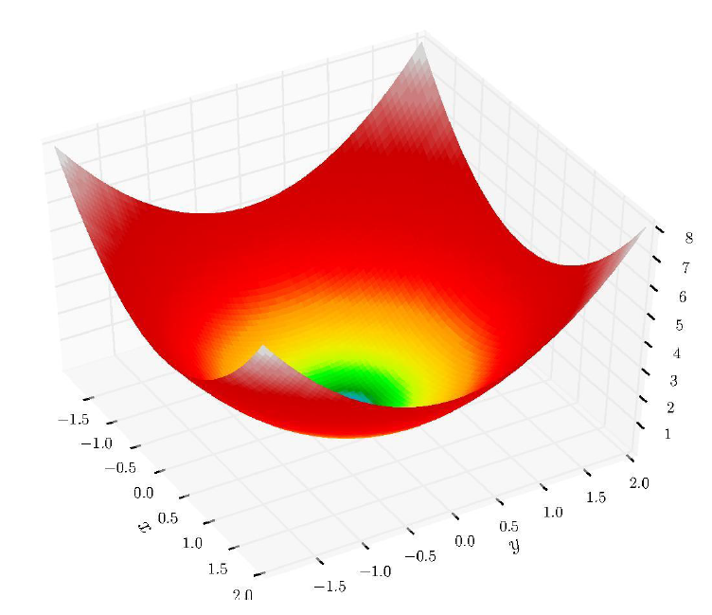
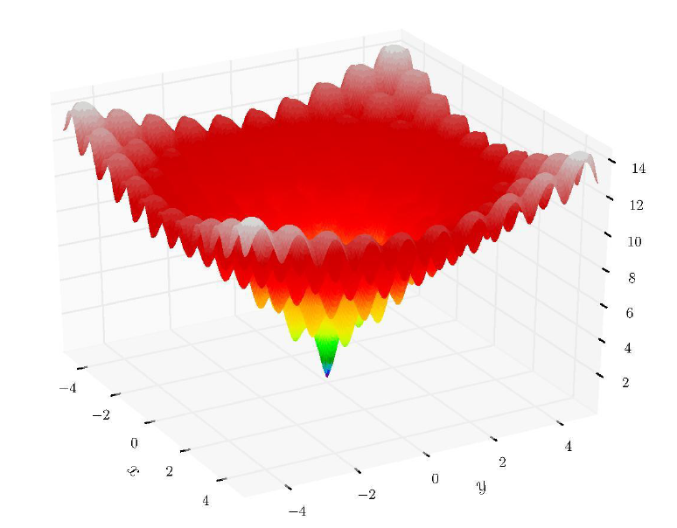
How hard can it be?

Slide 5
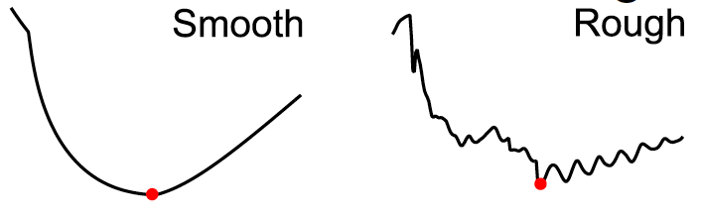
Optimization can be hard
Multiple local minima or saddle points
Expensive function evaluation (>> 1 s)
Noisy function evaluation (stochastic problem)
Rough landscape (numerical approximations, etc.)

Slide 6
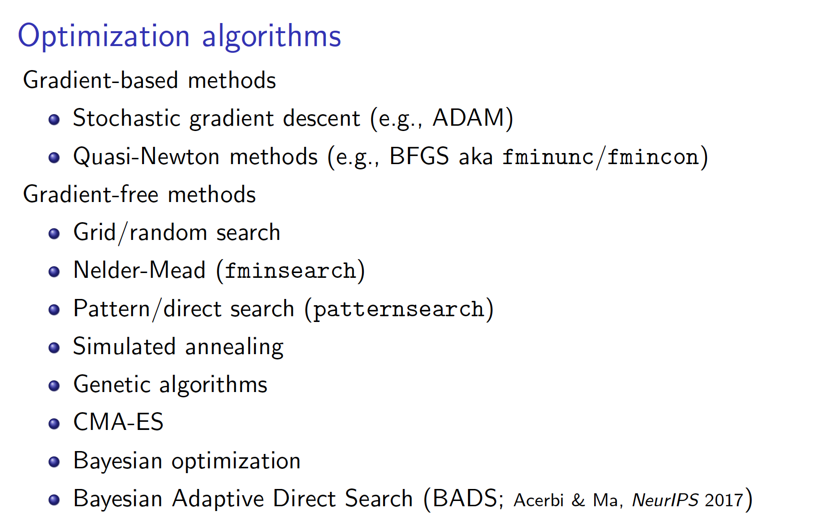
See intro to optimization by Luigi Acerbi in BAMB! 2022: https://github.com/lacerbi/bamb2022-model-fitting

Slide 7
Optimizers at work
BADS: Acerbi and Ma (2017)

Slide 8
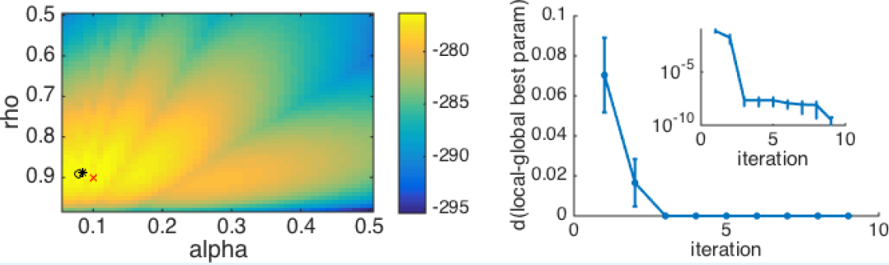
Tips and tricks
Make sure that your log-likelihoods are finite (e.g. initial conditions)
Carefully choose constraints on parameters: hard bounds and plausible bounds (avoid solutions at the bounds)
Consider reparameterization (independence between parameters)
Make sure that your log-likelihoods are finite (e.g. initial conditions)
Carefully choose constraints on parameters: hard bounds and plausible bounds (avoid solutions at the bounds)
Consider reparameterization (independence between parameters)
Beware of local minima (always run fitting multiple times with random initial conditions)
Wilson & Collins (2019) eLife

Slide 9
The plan for the next 120 minutes
Parameter estimation
Model fitting as an optimization problem
Model validation (tutorial part 1)
Does the model capture the data?
Parameter recovery (tutorial part 2)
Simulate, simulate, simulate!
Parameter uncertainty (tutorial part 3)
Bootstrapping

Slide 10
Model validation
Does the model capture the data in an absolute sense?
Does the model get the essence of the behavior?
How to validate the model?
Simulate the model with the fit parameter values and then analyze the simulated data in the same way that you analyzed the empirical data (model-independent analysis).
Verify that all important behavioral effects are captured by the model

Slide 11
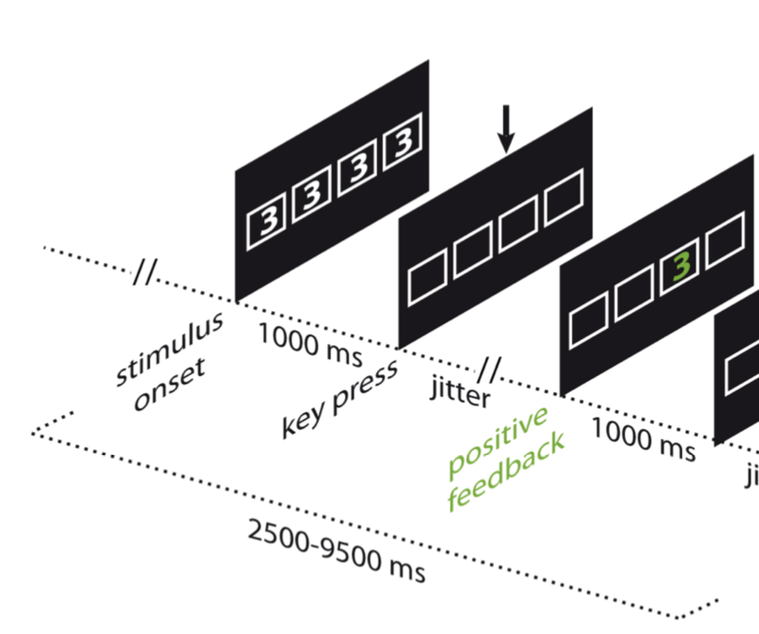
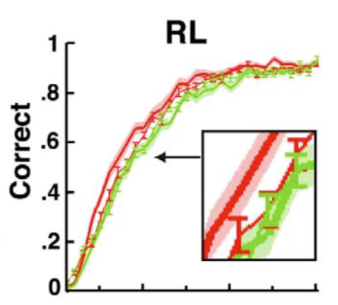
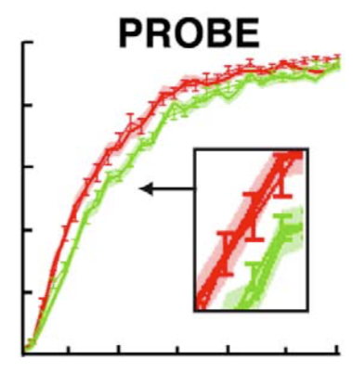
Example for qualitative criteria: what behavioral signatures do you care about
In cognitive and behavioral science, often our data points are trials or decisions or responses ...
... But not all responses matter equally ⚖️
Example: Both RL and PROBE models make similar predictions at the plateau level, after participants have learnt the contingencies
But after a reversal, key differences are observed:
Collins and Koechlin (2012)

Slide 12
The plan for the next 120 minutes
Parameter estimation
Model fitting as an optimization problem
Model validation (tutorial part 1)
Does the model capture the data?
Parameter recovery (tutorial part 2)
Simulate, simulate, simulate!
Parameter uncertainty (tutorial part 3)
Bootstrapping

Slide 13
Parameter recovery
Check whether the fitting procedure gives meaningful parameter values in the best case scenario, that is, when fitting fake data where the “true” parameter values are known.
🤷‍
Why do we care?
Palminteri, Wyart & Koechlin (2017) TICS; Wilson & Collins (2019) eLife

Slide 14
Parameter recovery
🤷‍
Why do we care?
We want to avoid a biased fitting procedure
We want to avoid parameter roles overlapping with each other, capturing similar shares of the variance
We want each parameter to be identifiable
Why do we care?
We want to avoid a biased fitting procedure
We want to avoid parameter roles overlapping with each other, capturing similar shares of the variance
We want each parameter to be identifiable
Under these conditions we will be able to interpret the meaning of each of the parameters
And potentially to interpret their different value in different conditions or under different treatment groups
Palminteri, Wyart & Koechlin (2017) TICS; Wilson & Collins (2019) eLife

Slide 15
Parameter recovery
1. Simulate fake data with different values of parameters (e.g., lapse rate, threshold, etc.)
When choosing the range of parameter values, make sure that you are covering the parameter regime of interest for your experiment!
Either sweep across the whole parameter space
Or focus on the space of interest regarding your best-fitting parameters
2. Estimate the values of the parameters from your simulated data
3. Compare the recovered parameters to their true values (should be highly correlated without bias)
Are there bugs in your code? Is the experiment underpowered?
Palminteri, Wyart & Koechlin (2017) TICS; Wilson & Collins (2019) eLife

Slide 16
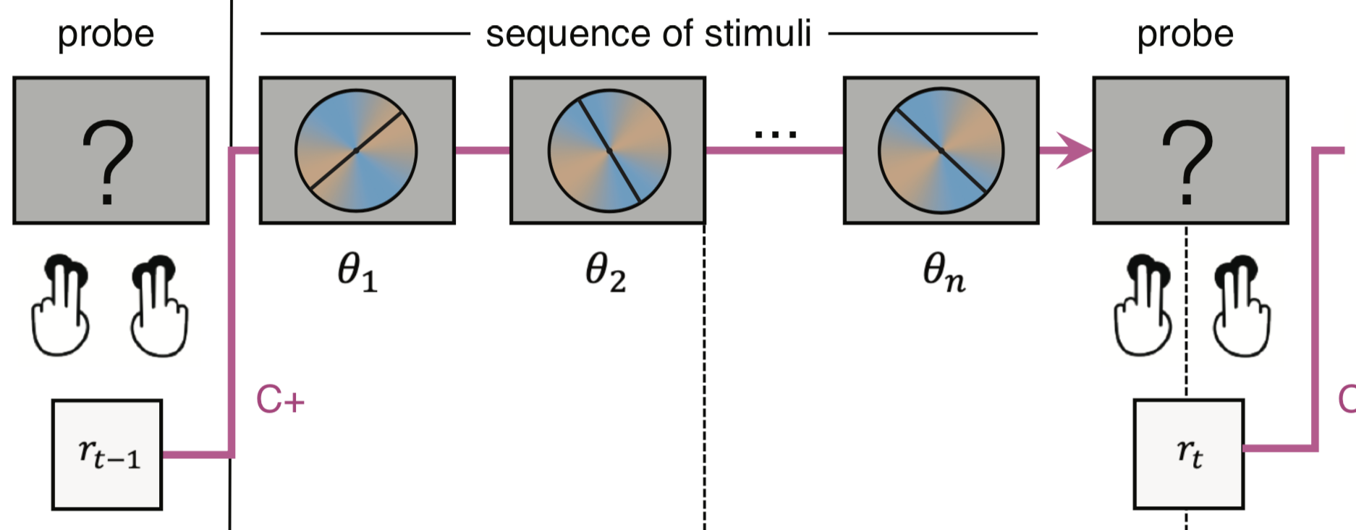
Example parameter recovery
Decision-making task under uncertainty
Bayesian inference model plus different sources of noise
Rouault et al, eLife (2022)

Slide 17
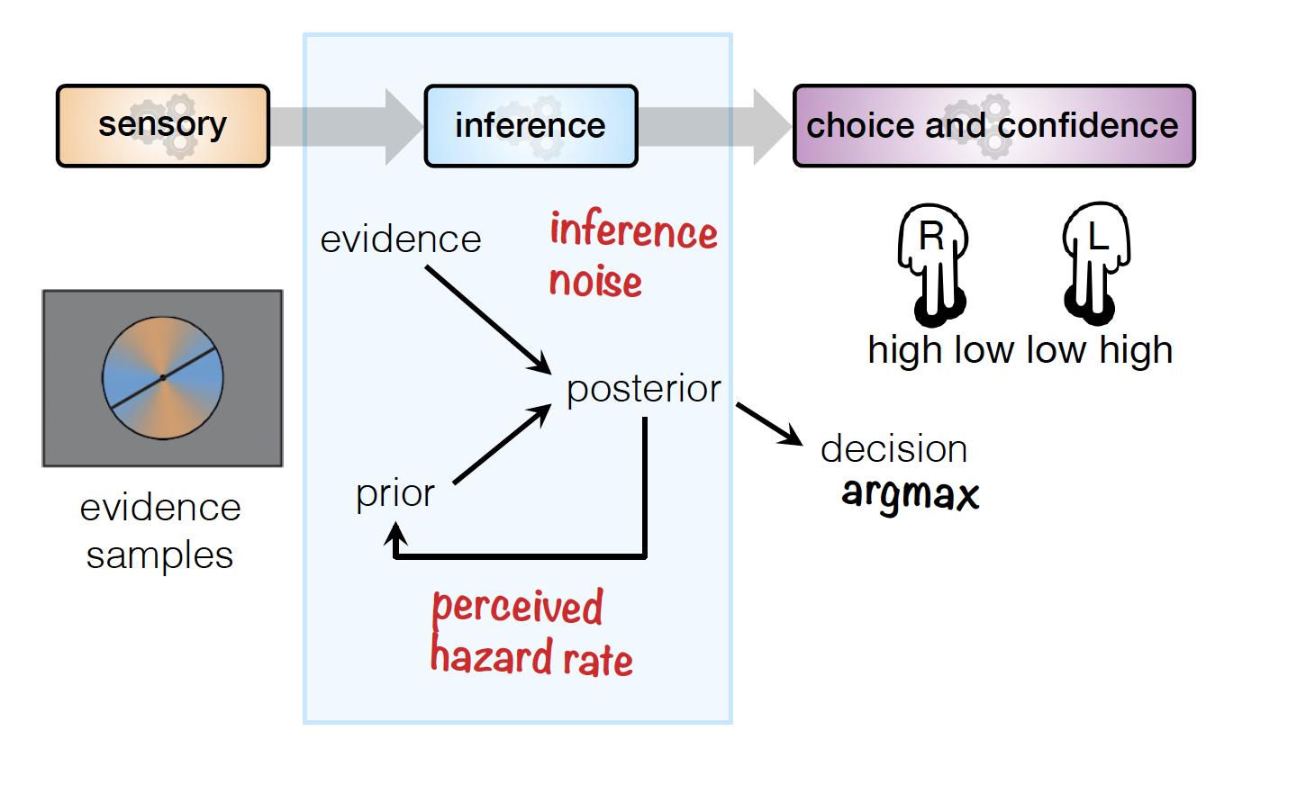
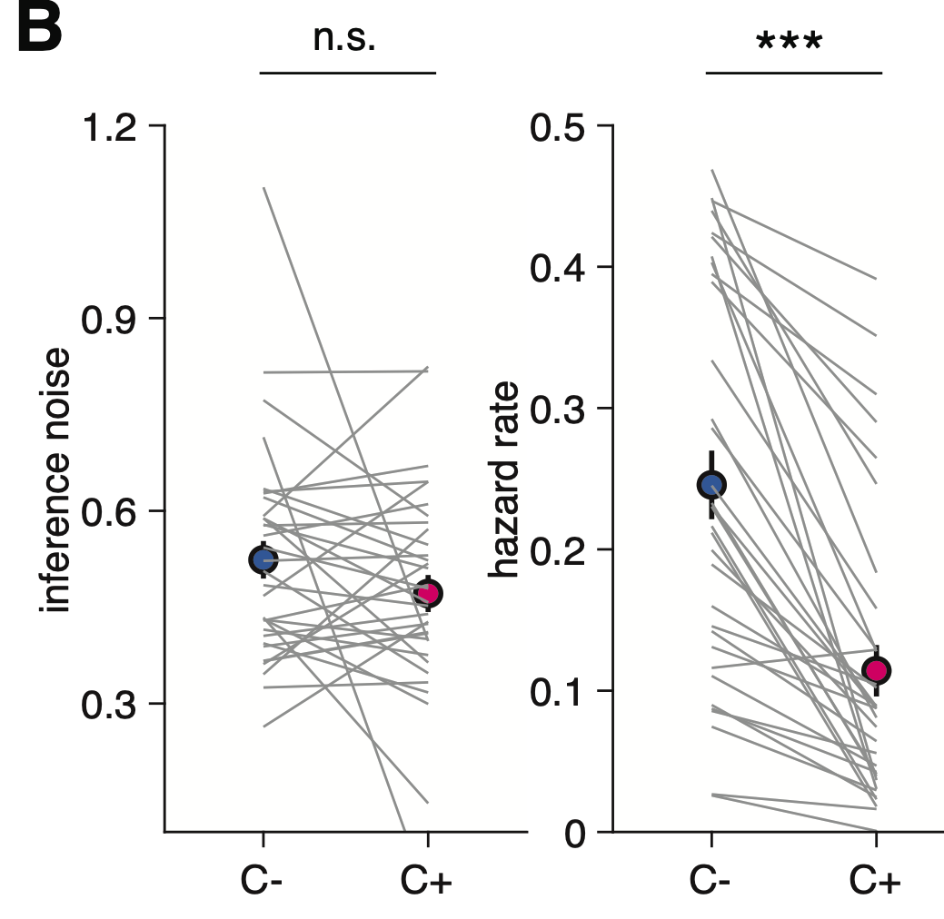
Example parameter recovery
Rouault et al, eLife (2022)

Slide 18
Example parameter recovery
Rouault et al, eLife (2022)

Slide 19
Example parameter recovery
Rouault et al, eLife (2022)

Slide 20
Example parameter recovery
Rouault et al, eLife (2022)

Slide 21
Confusion matrix: parameter identifiability
Rouault et al, eLife (2022)

Slide 22
The plan for the next 120 minutes
Parameter estimation
Model fitting as an optimization problem
Model validation (tutorial part 1)
Does the model capture the data?
Parameter recovery (tutorial part 2)
Simulate, simulate, simulate!
Parameter uncertainty (tutorial part 3)
Bootstrapping

Slide 23
Uncertainty about parameter estimates
Uncertainty around parameter estimates: how confident are you about your model fit?
Confidence interval of a population parameter: mean and confidence levels indicating the probability that the interval contains the parameter
Ideally, you would replicate your study several times and estimate the mean +/- margin of error
Uncertainty around parameter estimates: how confident are you about your model fit?
Confidence interval of a population parameter: mean and confidence levels indicating the probability that the interval contains the parameter
Ideally, you would replicate your study several times and estimate the mean +/- margin of error
Traditional statistical techniques are only asymptotically correct (large N)

Slide 24
Uncertainty about parameter estimates
In practice, we don’t know the underlying distribution from which your parameter is drawn: hence the error distribution cannot be easily calculated
In practice, we don’t know the underlying distribution from which your parameter is drawn: hence the error distribution cannot be easily calculated
Bootstrapping procedure, involves resampling your data
Repeatedly draw independent samples from a data set, that is, with replacement (resampling)
This creates a new data set, of same size as the initial one
We make the assumption that your data set is representative, a good measure of the underlying distribution

Slide 25
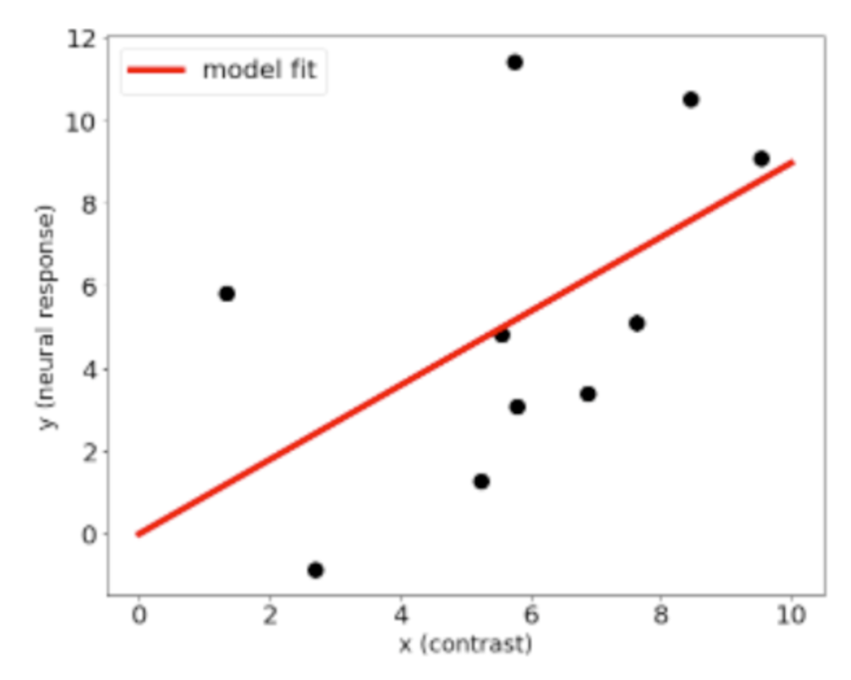
Example: Bootstrapping procedure
Uncertainty around parameter estimates: how confident are you about your model fit?
Example: a model fit of neural response as a function of contrast
Anqi Wu, neuromatch

Slide 26
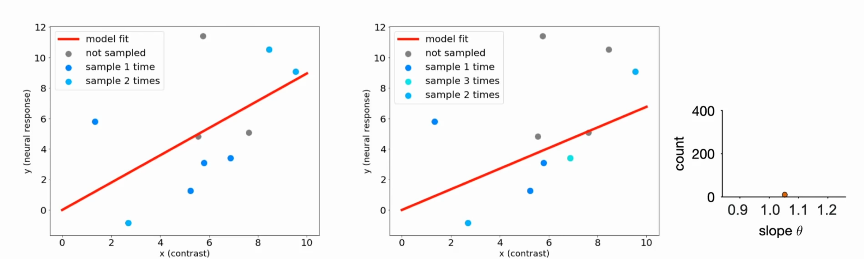
Bootstrapping procedure
1. Resample from the observed dataset with replacement

Slide 27
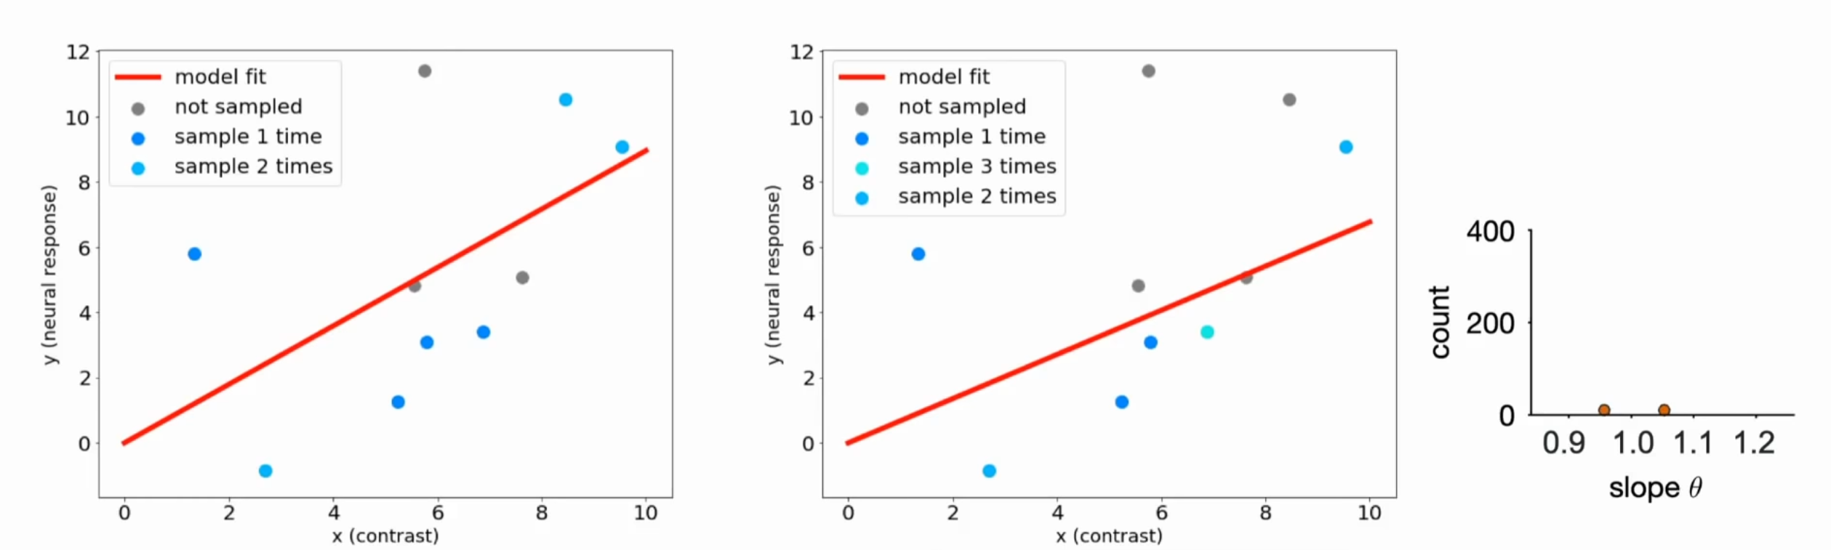
Bootstrapping procedure
1. Resample from the observed dataset with replacement

Slide 28
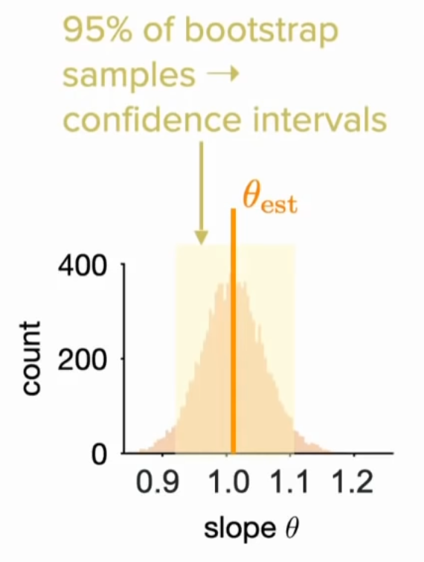
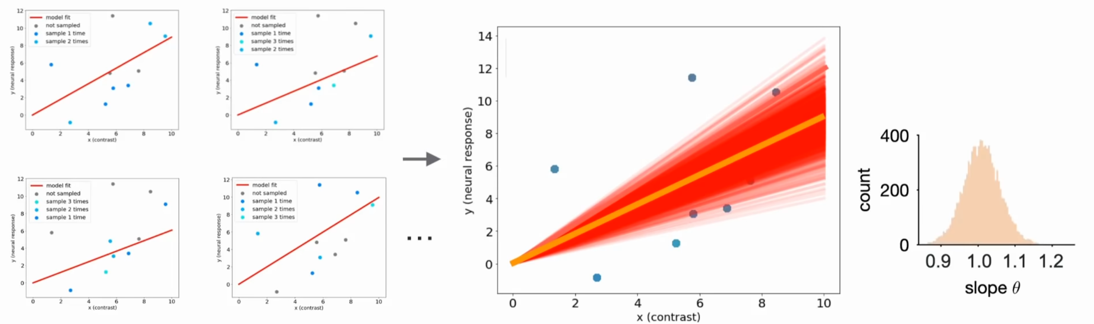
Bootstrapping procedure
Resample from the observed dataset with replacement
Collect all estimates into a distribution, and analyze the confidence intervals
The idea is to generate many new synthetic datasets from the initial true dataset by randomly sampling from it, then finding estimators for each one of these new datasets, and finally looking at the distribution of all these estimators to quantify our confidence.

Slide 29
Non-parametric vs. parametric bootstrap
How to generate synthetic data?
non-parametric bootstrap: simulate experiment based on observed data
parametric bootstrap: simulate experiment based on best parameters

Slide 30
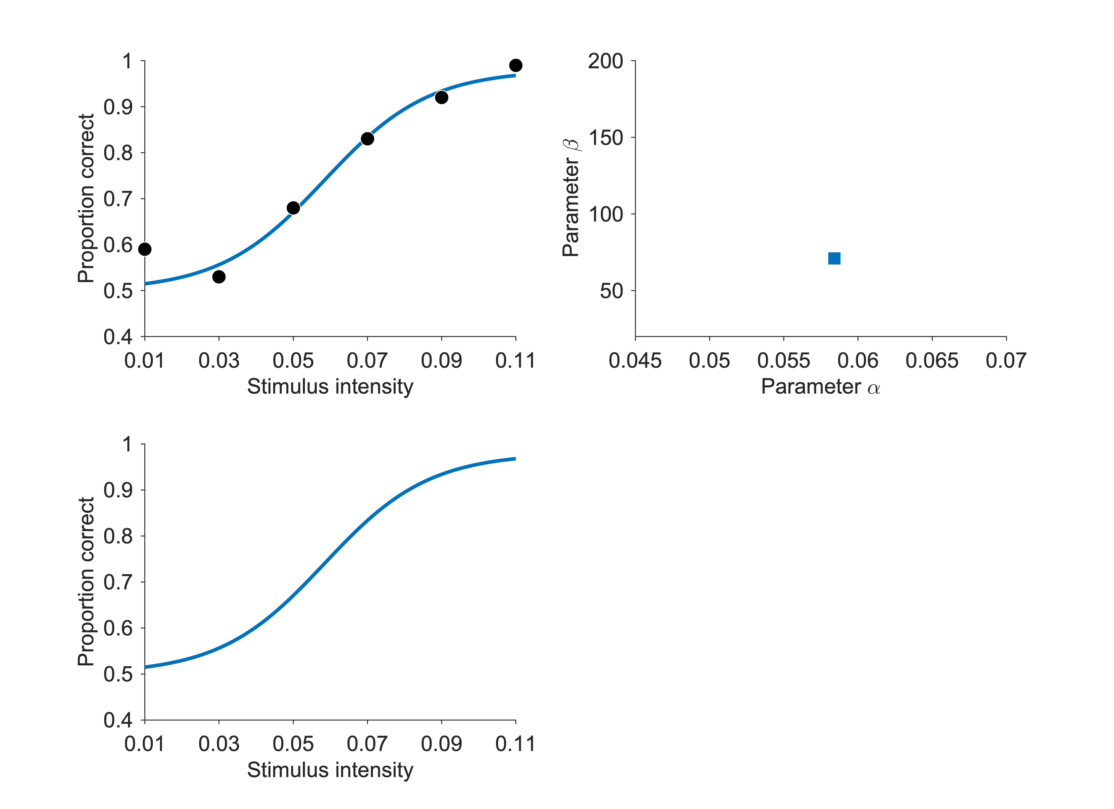
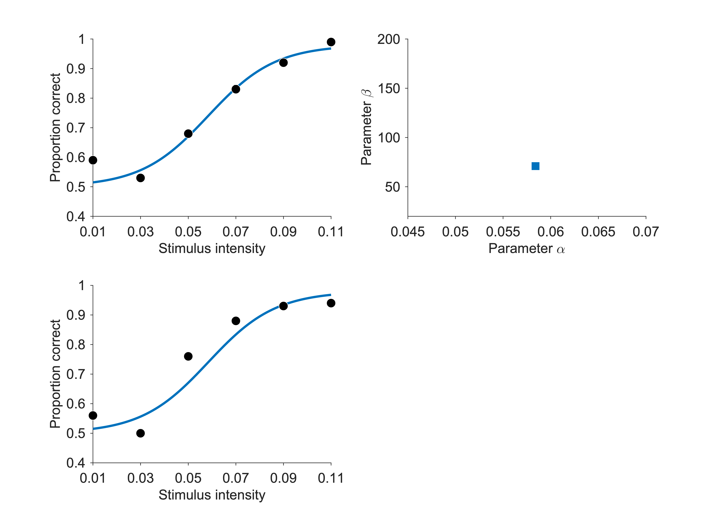
Bootstrap confidence intervals - Example
Data points and fit
Estimated parameters
Synthetic data
Generate synthetic data

Slide 31
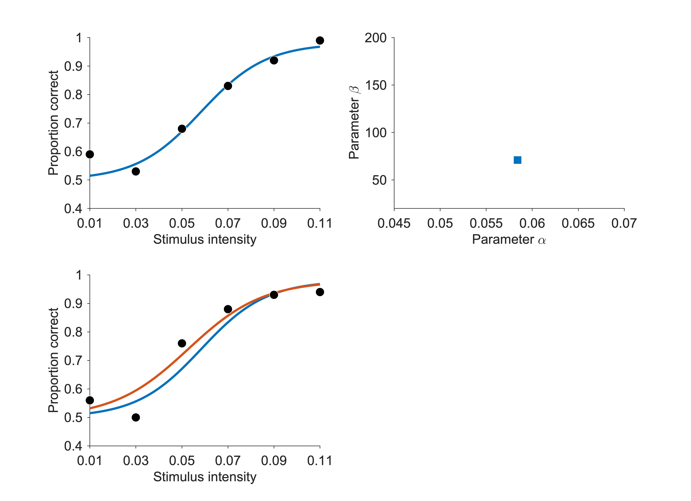

Bootstrap confidence intervals - Example
Data points and fit
Estimated parameters
Synthetic data
Generate synthetic data
Fit synthetic data

Slide 32
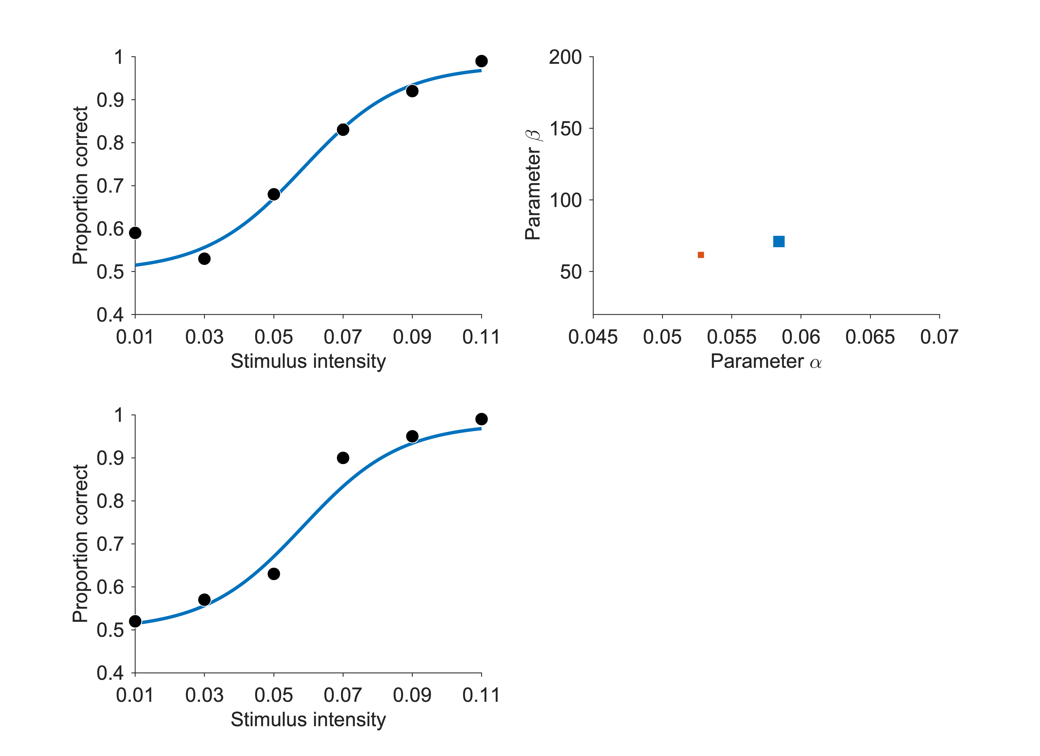
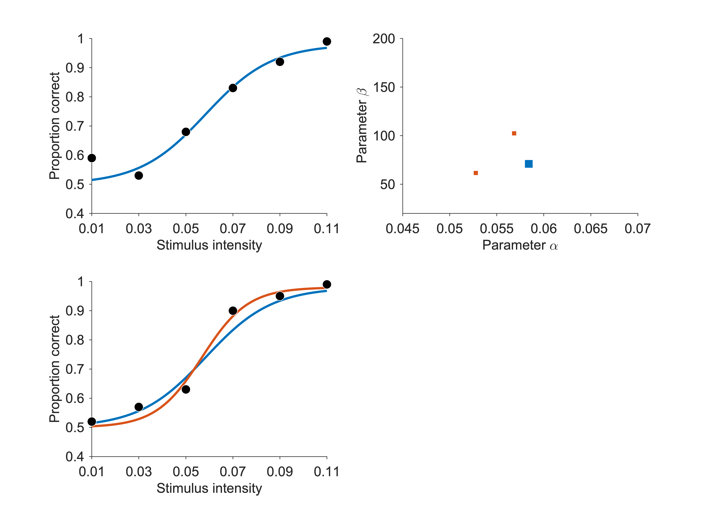
Bootstrap confidence intervals - Example
Data points and fit
Estimated parameters
Synthetic data
Generate synthetic data
Fit synthetic data
Repeat!

Slide 33
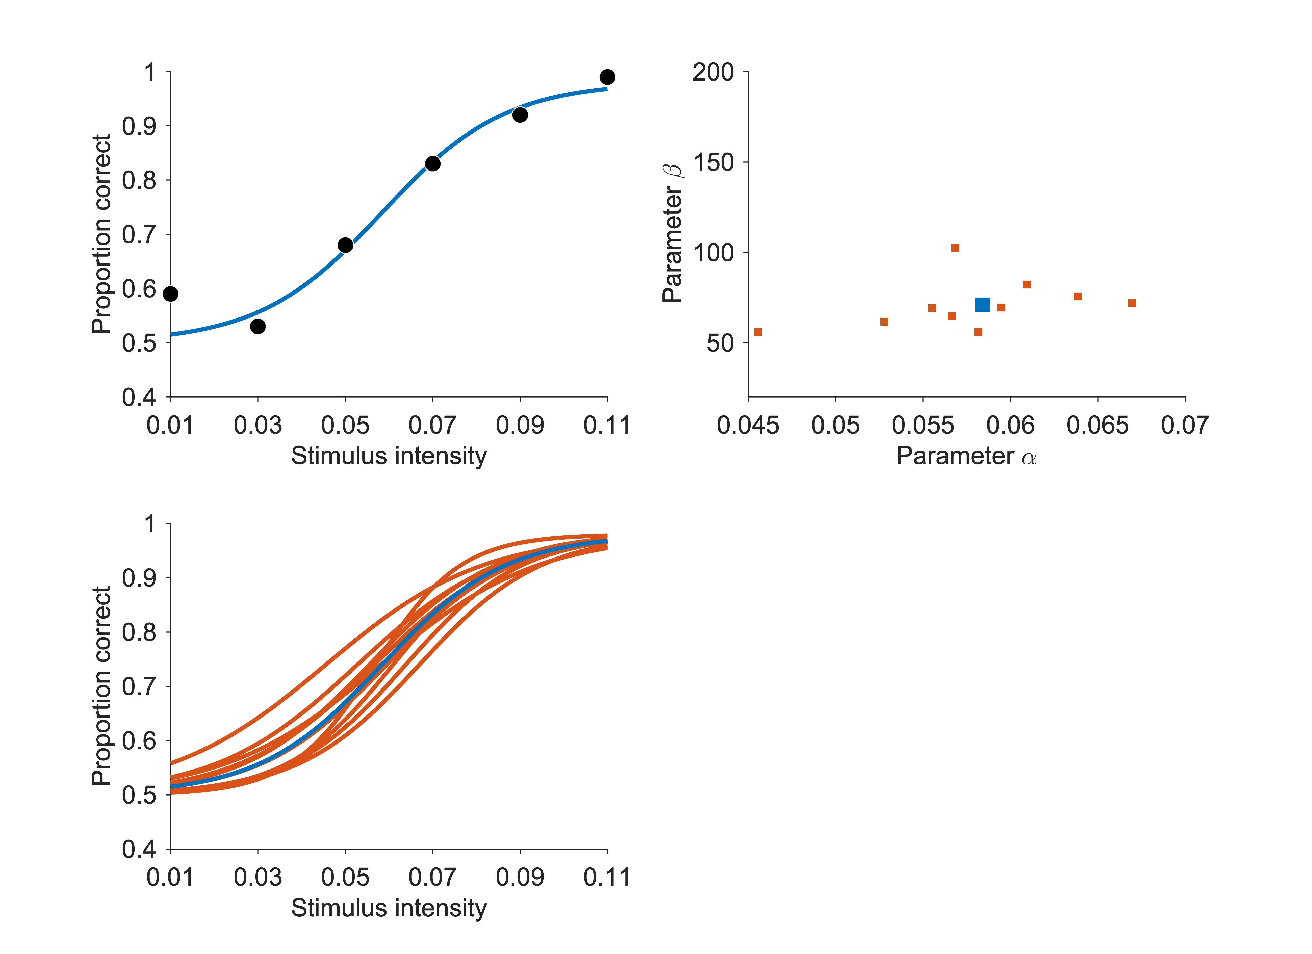
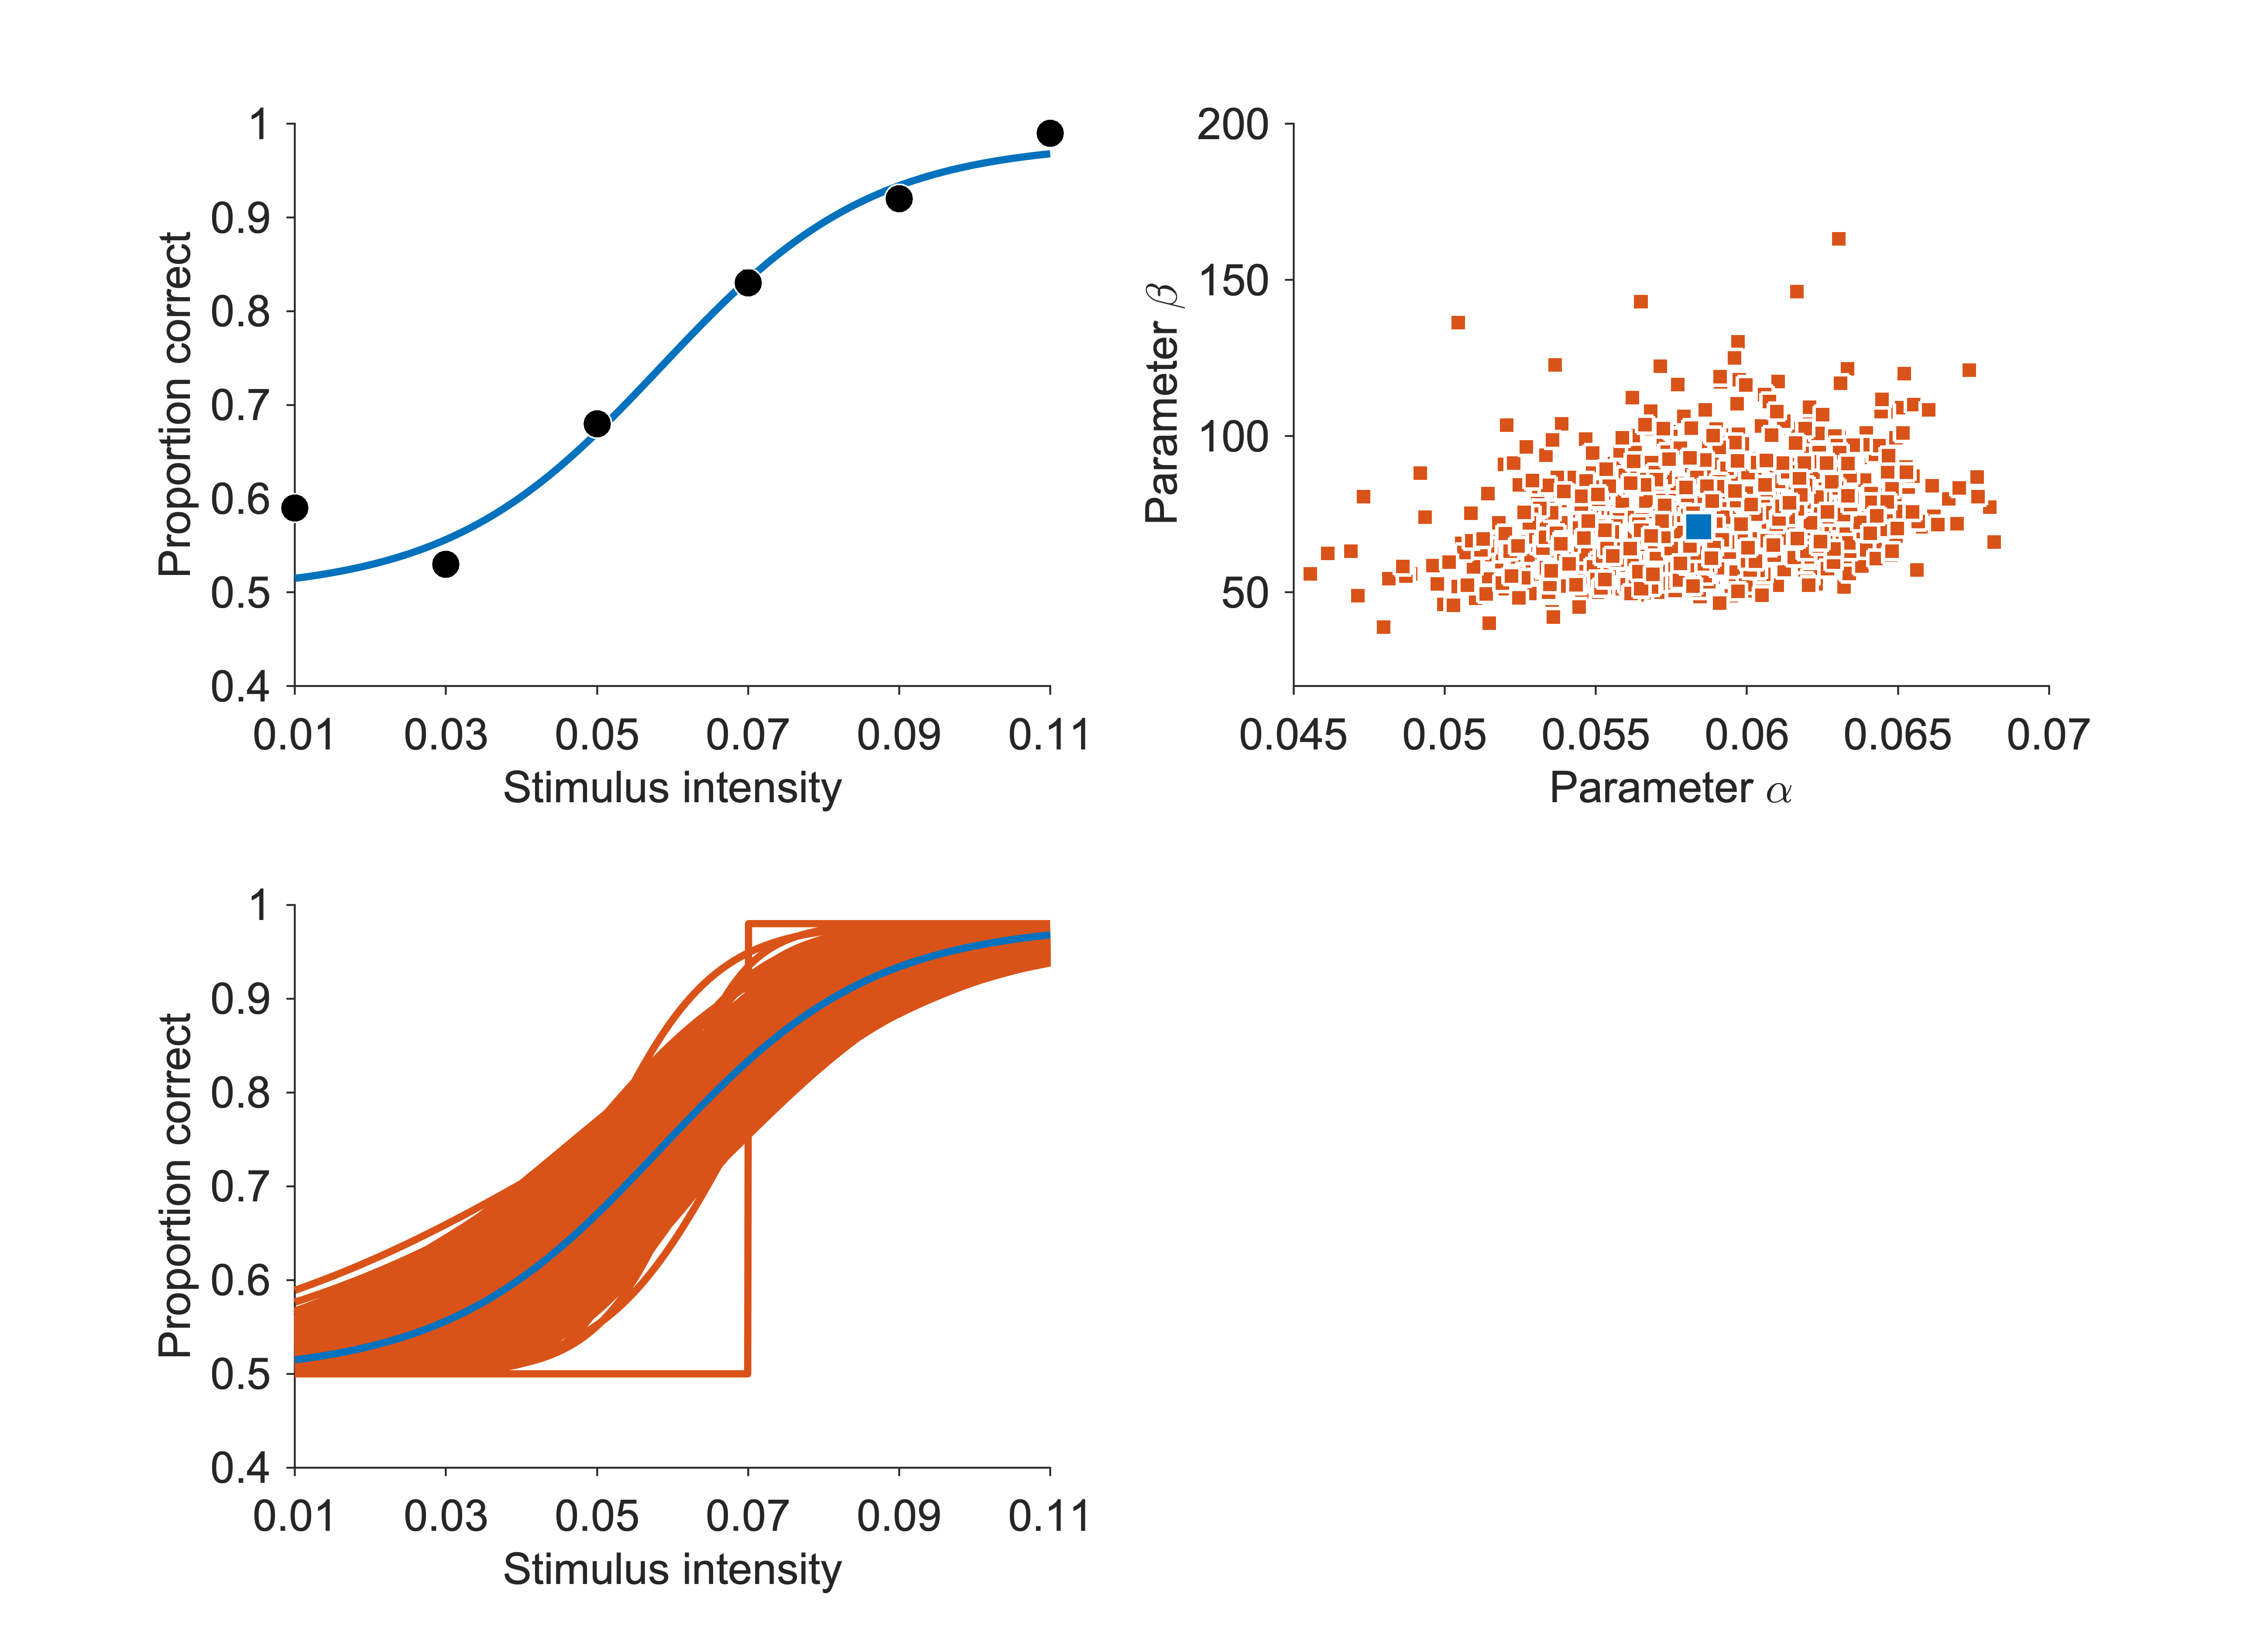
Bootstrap confidence intervals - Example
Data points and fit
Estimated parameters
Sampling distribution
Compute standard errors
Confidence intervals
etc …
Synthetic data
Generate synthetic data
Fit synthetic data
Repeat!

Slide 34
Acknowledgements
🙏
Marion Rouault, CNRS & Paris Brain Institute (BAMB! 2022)
Luigi Acerbi (BAMB! 2022)
Anqi Wu (Neuromatch)

Slide 35
Backup slides

Slide 36
Example: model validation
Decision-making task under uncertainty
Bayesian inference model plus different sources of noise
Rouault et al, eLife (2022)

Slide 37
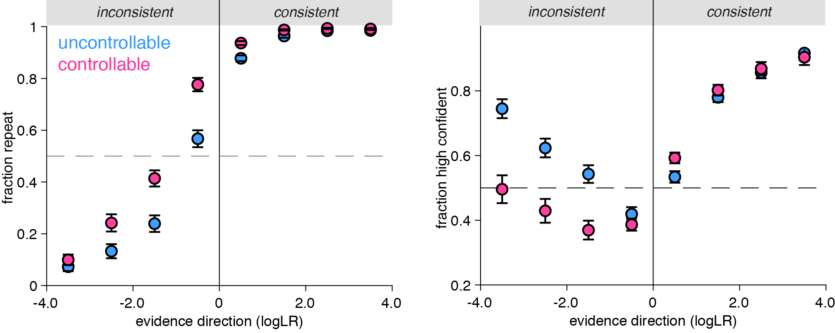
Example model validation
Participants need more evidence to change their mind in controllable environments
When they change their mind, they do so with reduced confidence
Rouault et al, eLife (2022)

Slide 38
Example model validation
Rouault et al, eLife (2022)

Slide 39
Example model validation
Rouault et al, eLife (2022)

Slide 40
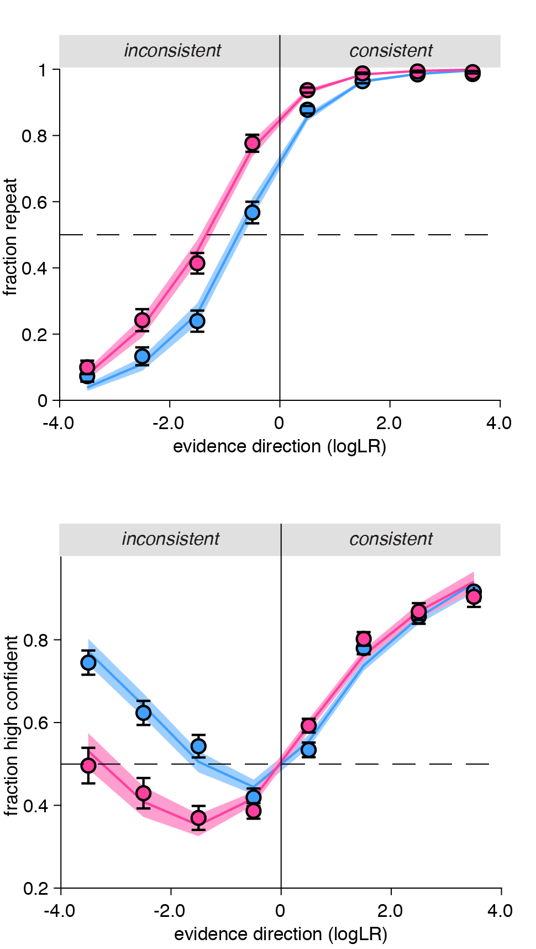
Example model validation
Full model
Reduced model
💭 Can you recover/
reproduce all qualitative and quantitative results obtained from your actual data?
Rouault et al, eLife (2022)

